Slide 1
Hyperlinks and images
EXERCISE 2

Slide 2
Hyperlinks
References to:
  another HTML page;
  external Internet resources;
  files;
  e-mail addresses;
  text from the page.
Text or image.

Slide 3
Hyperlinks - element <a>
<a href=“someURL”>Some text</a>

Slide 4
Types of hyperlinks
Global – to other Internet resources
<a href=“https://www.tu-varna.bg/tu-varna/”/>ТУ-Варна</a>
Local – to other pages on the same site
<a href=“../info/aboutus.html”>За нас</a>
Email hyperlinks
<a href="mailto:myemail@mail.bg">Email to us </a>

Slide 5
Types of hyperlinks
Hyperlinks to a file
<a href=“students.xlsx” download>Изтегли списък на студентите</a>
Internal – to anchors on the same page
<h2 id=“aboutus”>About us</h2> <a href=“#aboutus”>About us</a>

Slide 6
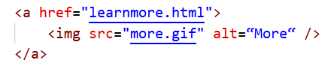
Image hyperlink

Slide 7
Some attributes
href=“../info/aboutus.html”
target=“_self | _blank | _parent | _top”
title – text that appears when the mouse hovers over the link
download

Slide 8
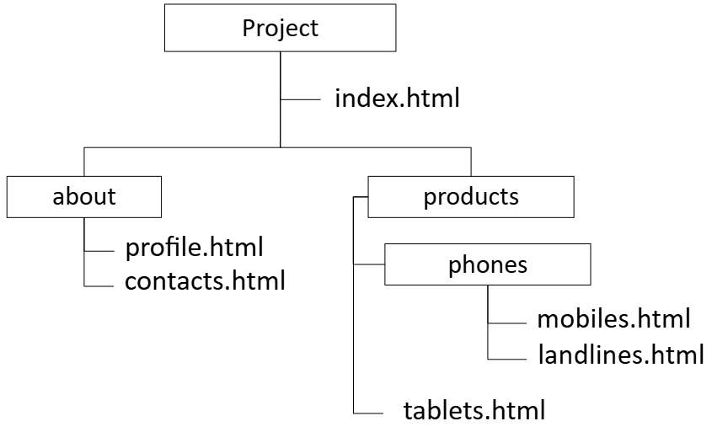
Specifying a path in a hyperlink
от index.html:
  href= "about/profile.html" | href="./about/profile.html"
  href=“products/phones/mobiles.html”
от profile.html:
  href="../index.html"
от tablets.html:
  href="phones/mobiles.html"
от mobiles.html:
  href="../../index.html"
  href="../tablets.html"
  href="../../about/profile.html"

Slide 9
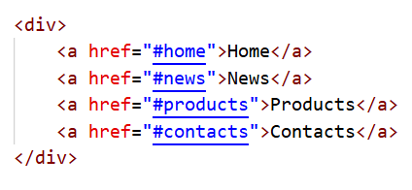

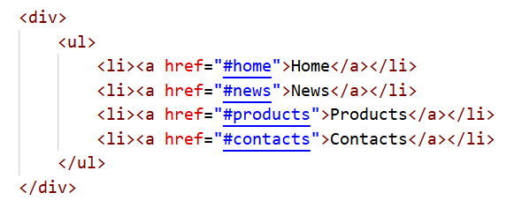
Navigation

Slide 10
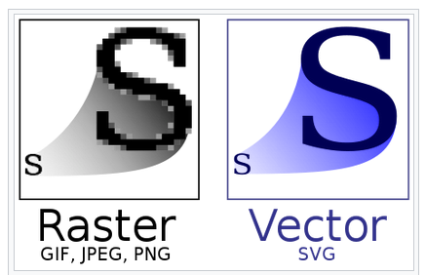
Image formats supported by browsers
Формат | Характеристики | Употреба
GIF | 256 (8-bit color) Lossless compression Supports transparency Ability to create animated images | High-sharpness images, limited colors, text Logo Graphics Charts Some animated images
JPEG | 16.7 million (24-bit color) Lossy compression | Images with many blending colors Still images
PNG | 16.7 million (24-bit color) Lossless compression Supports transparency | When more precise image reproduction is required When transparency is required
SVG | Scalable Vector Graphics | Ideal for user interface elements, icons, diagrams, etc., that need to be drawn precisely at various sizes.
WebP | Web image format Lossless and lossy compression Much better compression than PNG or JPEG | When greater color depths, animated frames, transparency, etc., are required.
Other: APNG, AVIF... More: https://developer.mozilla.org/en-US/docs/Web/Media/Formats/Image_types

Slide 11

Image – element <img />
<img src=“roses.jpg" alt=“A vase with red roses“ />

Slide 12
Some attributes
src=“roses.jpg”
alt=“A vase with red roses“
title=“My birthday flowers” – text that appears when the mouse hovers over the image
width, height

Slide 13
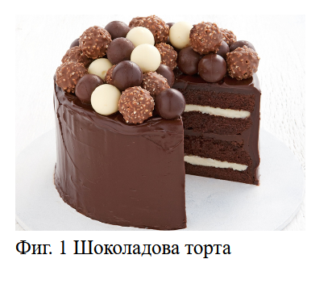
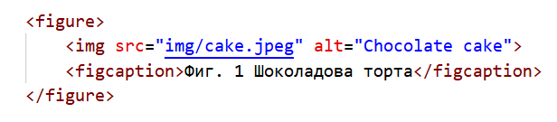
Element <figure>

Slide 14
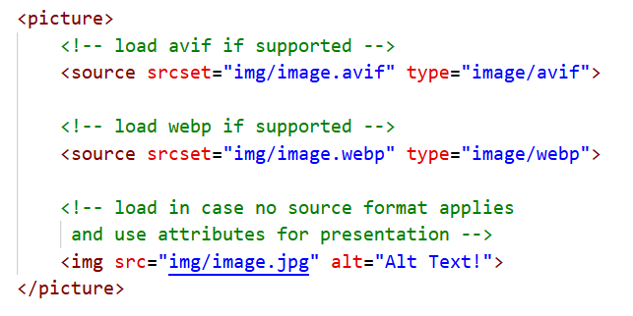
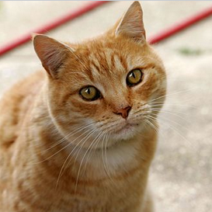

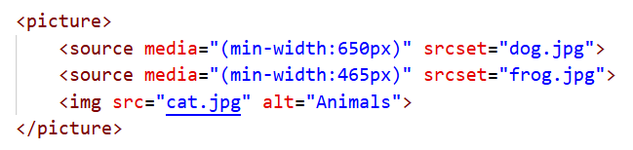
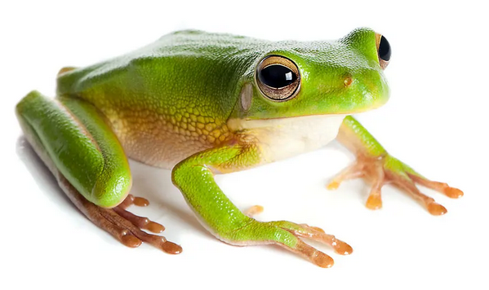
Element <picture>

Slide 15
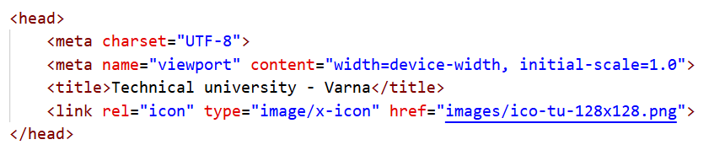

Favicon
A small icon that identifies a website in the browser.
It is most commonly displayed:
  in the browser tab next to the page title;
  in the bookmarks list;
  in the browser history;
  in site shortcuts on the browser's home screen.

Slide 16

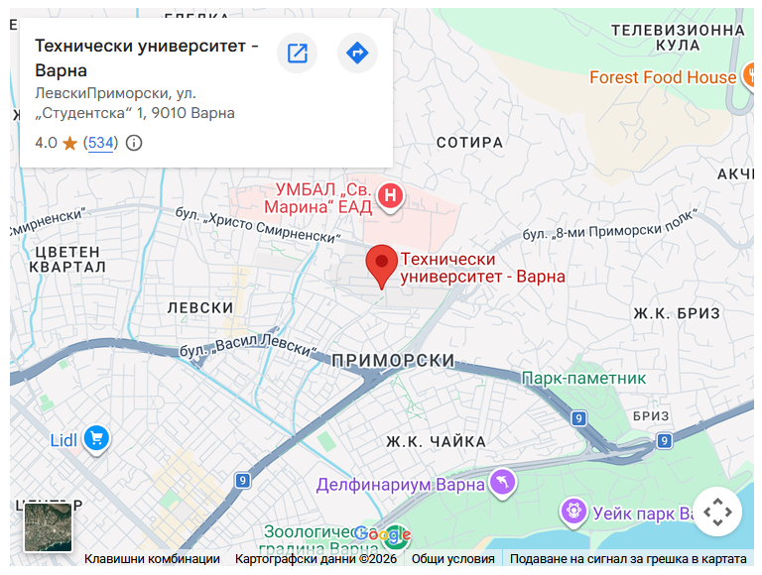
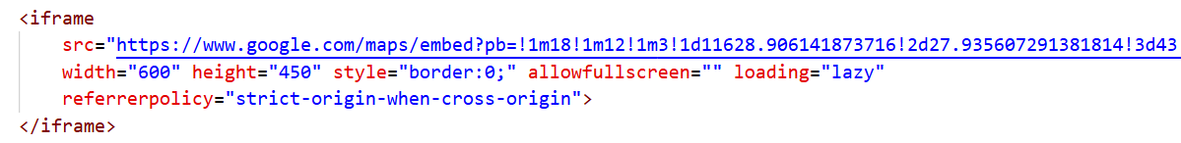
Embedding an external component
<iframe>
<object>

